Slide 1

Presenter Name : Ruchitha K M USN : 4VP24MC041
Loan Default Prediction using Machine Learning
REVIEW-2 Presentation
Notes:
Loan Default Prediction using Machine Learning

Slide 2
INTRODUCTION
Company Name: Comedkares ERA Foundation
Internship Title: Data Science and AI\ML
External Guide: Ms. Kavya Rao
Internal Guide: Prof. Neema H
Project Title: Smart Banking Loan Prediction System
Department of MCA, VCET Puttur

Slide 3
CONTENTS
Company Profile
Title Introduction
Objectives
Software Requirements Specification
Flow Diagram
Project Carried Out
Conclusion
Department of MCA, VCET Puttur

Slide 4
COMPANY PROFILE
COMEDKARES is an innovation initiative by ERA Foundation in collaboration with COMEDK.
The Mangalore center provides hands-on training and practical learning for engineering students.
It focuses on emerging technologies such as Artificial Intelligence, Robotics, and IoT.
The center offers advanced lab facilities including 3D printing, robotics kits, and smart device development.
It aims to enhance student skills, innovation, and industry readiness through real-time projects.
Department of MCA, VCET Puttur

Slide 5
INTRODUCTION
Loan default prediction is a crucial task for financial institutions, as it helps identify borrowers who may fail to repay their loans.
Traditional credit scoring methods mainly rely on limited borrower financial history, which may not accurately capture the true repayment risk.
With the advancement of technology, machine learning techniques enable the analysis of large borrower datasets efficiently. These models can predict potential loan defaults at an early stage, improving decision-making for financial institutions.
As a result, banks can reduce financial losses, manage risks effectively and enhance the overall quality of their lending process.
Department of MCA, VCET Puttur

Slide 6
SOFTWARE REQUIREMENTS SPECIFICATIONS
Functional Requirements:
User Registration and Login
Loan Application Submission
Loan Default Prediction
Risk Classification
Admin Dashboard Management
Loan Approval and Rejection
Prediction History Storage
Database Management
Department of MCA, VCET Puttur

Slide 7
SOFTWARE REQUIREMENTS SPECIFICATIONS
Non-functional Requirements:
Performance
Security
Reliability
Usability
Scalability
Department of MCA, VCET Puttur

Slide 8
SOFTWARE REQUIREMENTS SPECIFICATIONS
Hardware Requirements:
Processor: Intel i3 or above
RAM: Minimum 4 GB
Storage: Minimum 500 MB free space
System: Windows / Linux / Mac
Department of MCA, VCET Puttur

Slide 9
SYSTEM REQUIREMENTS
Software Requirements:
Frontend: HTML, CSS, JavaScript
Backend: Python (Flask Framework)
Database: MYSQL
Model Algorithm: Random forest classifier, Logistic Regression, LightGBM
Tools: VS Code, Web Browser
Department of MCA, VCET Puttur

Slide 10
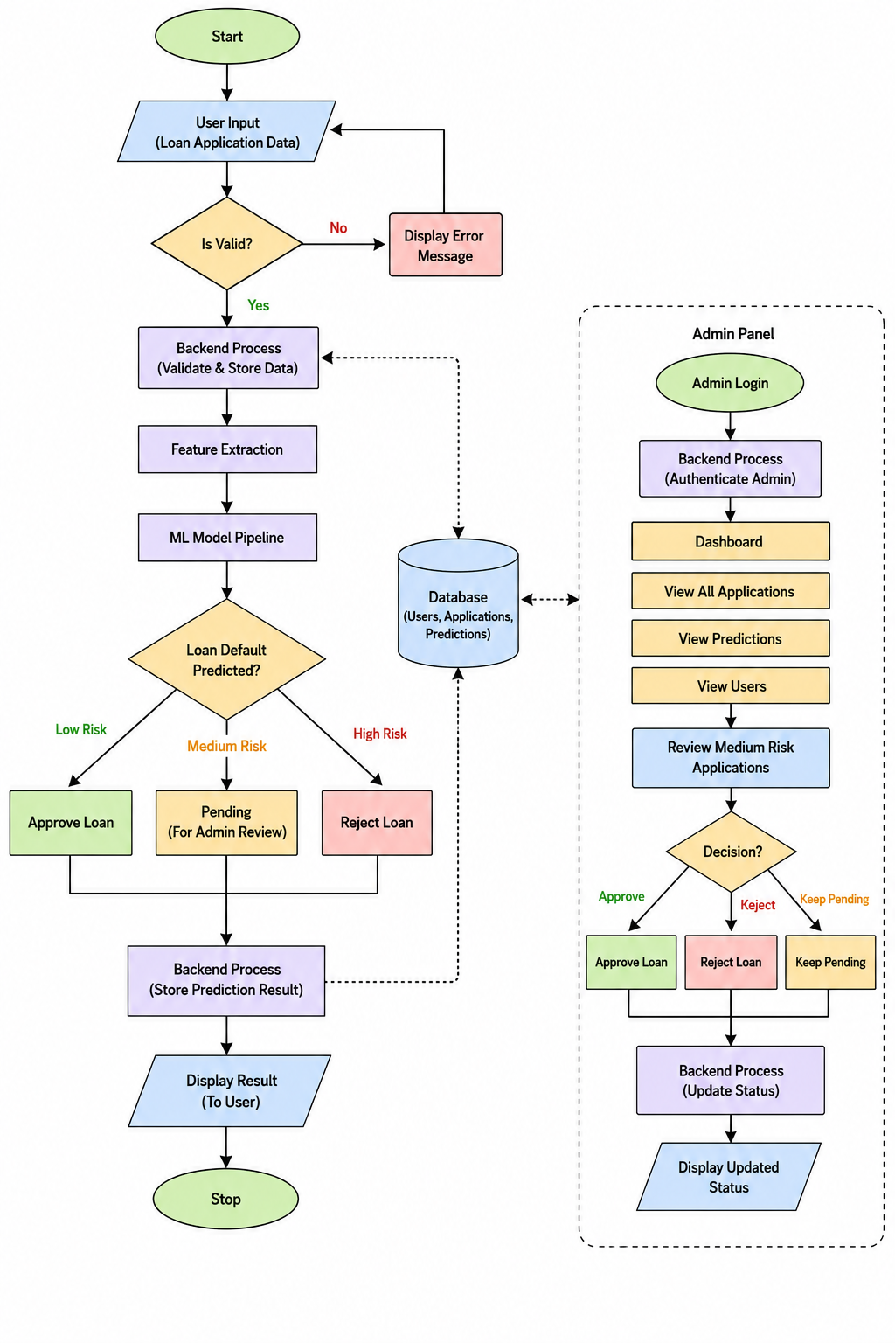
FLOW DIAGRAM
Figure 1.1 : System Flow of the Loan Default Prediction System
Department of MCA, VCET Puttur

Slide 11
PROJECT CARRIED OUT
Project Objectives:
To develop a machine learning model for loan default prediction
To automate the loan risk assessment process
To create a user-friendly web application
To improve decision-making for loan approval
To maintain and analyze applicant records efficiently
Department of MCA, VCET Puttur

Slide 12
PROJECT CARRIED OUT
Methodology
The system collects loan applicant details such as income , credit score, employment status and loan amount.
The collected data is cleaned and preprocessed to remove errors and handle missing values.
Important features are extracted and given to the machine learning model for analysis.
The trained model predicts whether the applicant belongs to Low Risk, Medium Risk, or High Risk category.
The prediction result is stored in the database and displayed to the user, while the admin can review and manage loan applications.
Department of MCA, VCET Puttur
Notes:
Important features are extracted and given to the machine learning model for analysis.

Slide 13
PROJECT CARRIED OUT
Modules Developed
Flask
MYSQL
Random Forest
Logistic regression
LightGBM
Challenges Faced
Data Quality Issues – Missing or incorrect data
Imbalanced Dataset – Fewer default cases than non-default
Model Accuracy – Difficulty achieving high accuracy
Feature Selection – Choosing important factors
Overfitting – Model works well on training but not on new data
Department of MCA, VCET Puttur

Slide 14
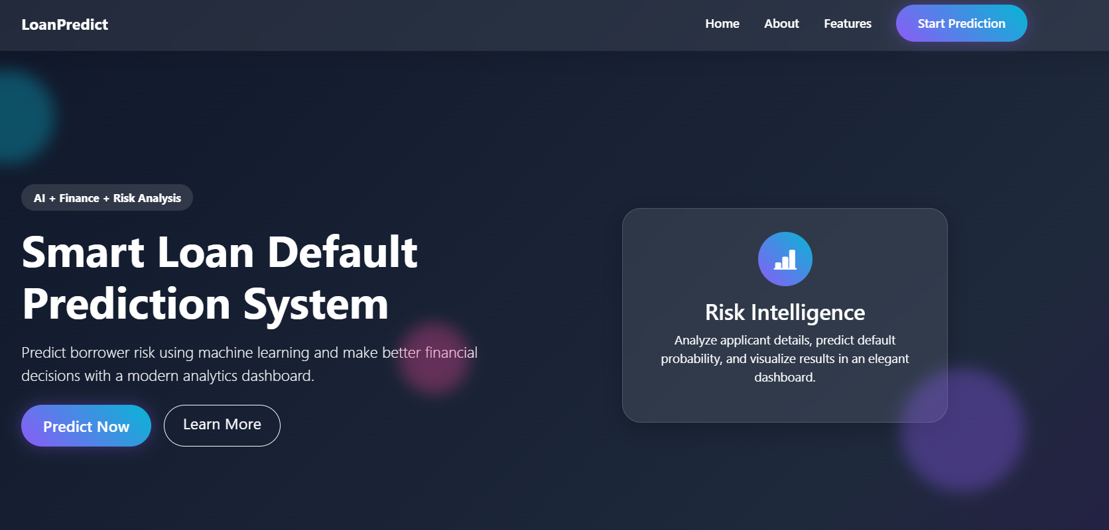
PROJECT CARRIED OUT
Solutions Implemented
Figure 1.2 : Home Page
Department of MCA, VCET Puttur

Slide 15
FUTURE ENHANCEMENTS
The system can be enhanced by using advanced machine learning and deep learning algorithms to improve prediction accuracy.
Real-time bank transaction and credit bureau integration can be added for better loan risk analysis.
A mobile application can be developed to provide easy access for users and administrators.
The project can include biometric authentication and OTP verification for improved security.
Advanced analytics and graphical dashboards can be added for better monitoring of loan applications and prediction history.
Department of MCA, VCET Puttur

Slide 16
CONCLUSION
The Loan Default Prediction System is a machine learning–based web application developed to predict the risk level of loan applicants and assist in better loan approval decisions.
The system analyzes applicant details such as income, credit score, employment status, loan amount, and repayment history to classify users into Low, Medium, or High risk categories.
It also provides features such as user registration, loan application submission, prediction history, and an admin dashboard for managing applications and users. By automating the loan risk assessment process, the project helps reduce manual effort, improve prediction accuracy, and minimize financial losses for banks and financial institutions.
Department of MCA, VCET Puttur

Slide 17
THANK YOU
Department of MCA, VCET Puttur

